Slide 1
Data Architecture

Slide 2
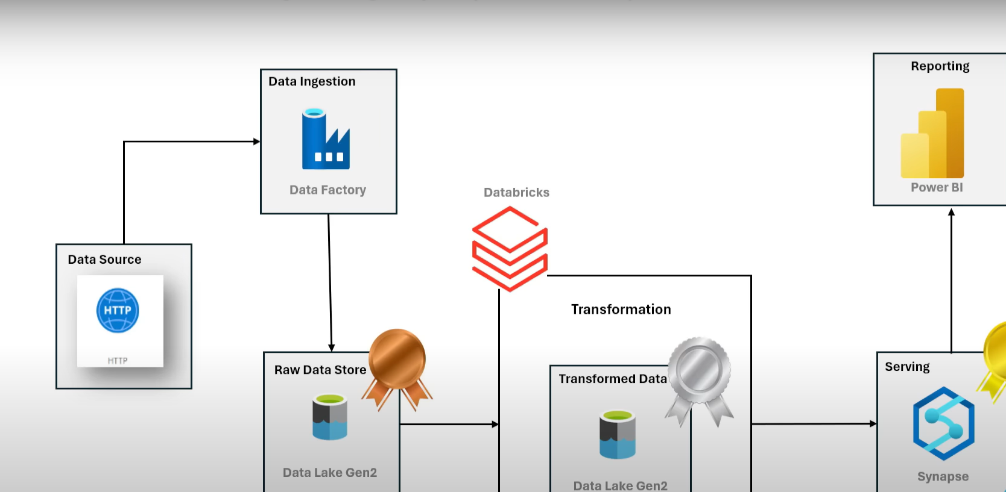
Hi Everyone,
I am Shankar, working as an Azure Data Engineer. I’m excited to share my latest project with you. I hope you find it insightful and engaging.
Below is the data architecture I’ve implemented for this project. It is based on the Multi-Hop Architecture (also known as the Medallion Architecture), which includes three layers: Bronze, Silver, and Gold.

Slide 3
Bronze Layer
Source Data:
The data is sourced from an HTTP connection, enabling the ingestion of real-time data streams.
Data Orchestration:
Here, azure Data Factory is implemented as the orchestration tool to extract data from the source and load it into the Azure Data Lake.
Raw Data Storage:
The Bronze Layer stores raw, unprocessed data exactly as received from the source, without any transformations or cleaning. Stored as a CSV file.
What I will do:
Serve as the ingestion layer in the data architecture, ensuring seamless and efficient data capture from source systems.
Implement both static pipelines for predefined data patterns and dynamic pipelines to handle flexible or real-time data streams.

Slide 4
Silver Layer
What will I do:
In this layer, we interact with Databricks to transform the raw data from the Bronze Layer.
To connect the databricks with datalake storage , I will connect through service principle application.
Transformation logic is implemented based on the specific requirements for analysis, such as cleaning, filtering and enriching the data.
After the transformation process, the resulting data is stored in Parquet file format within the Azure Data Lake under the Silver Layer.
The Silver Layer contains refined and structured data, making it ready for downstream processes, including advanced analytics and reporting.

Slide 5
Gold Layer
Use Azure Synapse and Power BI for analyzing data and creating dashboards for stakeholders.
Create views from Silver Layer data stored in Parquet format.
Build Delta Tables from Gold Layer Views for consistency and scalability.
Use a serverless database in Azure Synapse for cost-effective querying and data management.
Deliver curated datasets optimized for reporting, visualization, and decision-making.

